Slide 1
CityGeomodel and MAKUdigi projects
Hilkka Kallio
Geological Survey of Finland
22th January 2019
Geotechnical Data Standardization Workshop - Paris

Slide 2

CityGeoModel – open geological data model for cities
CityGeoModel was an initiative to develop the use of open geological data
in construction and city planning
with the 3D city modelling
It was funded by European Regional Development Fund (ERDF) and was based on the 6Aika –strategy - a strategy for sustainable urban development of the 6 largest cities in Finland.
CityGeoModel was part of a large-scale spearhead projects: Open Data and Interfaces.
Project partners:
Geological Survey of Finland
City of Tampere
www.citygeomodel.fi

Slide 3
Geological information system for a city
Site specific models
Merging
generalization
Model based design
Geomodel for extensive area
Geological models sedimentary (soil) and Precambrian (bedrock)
Surface creation
Interpretations
surface points
collar –survey –lithology tables
Surface creation
Data catalogue
Interpretation and
adjustment
InfraModel
Harmonized geological data
Source data
Harmonization

Slide 4
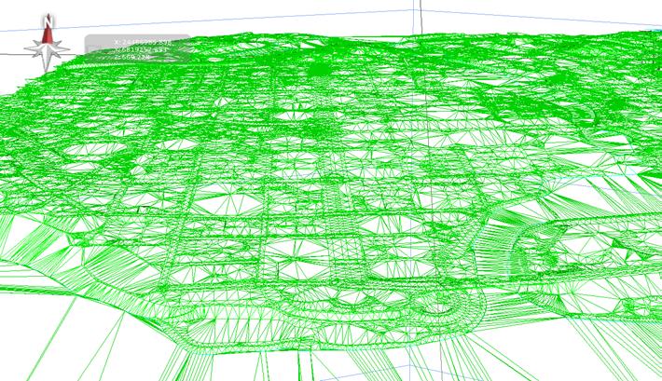
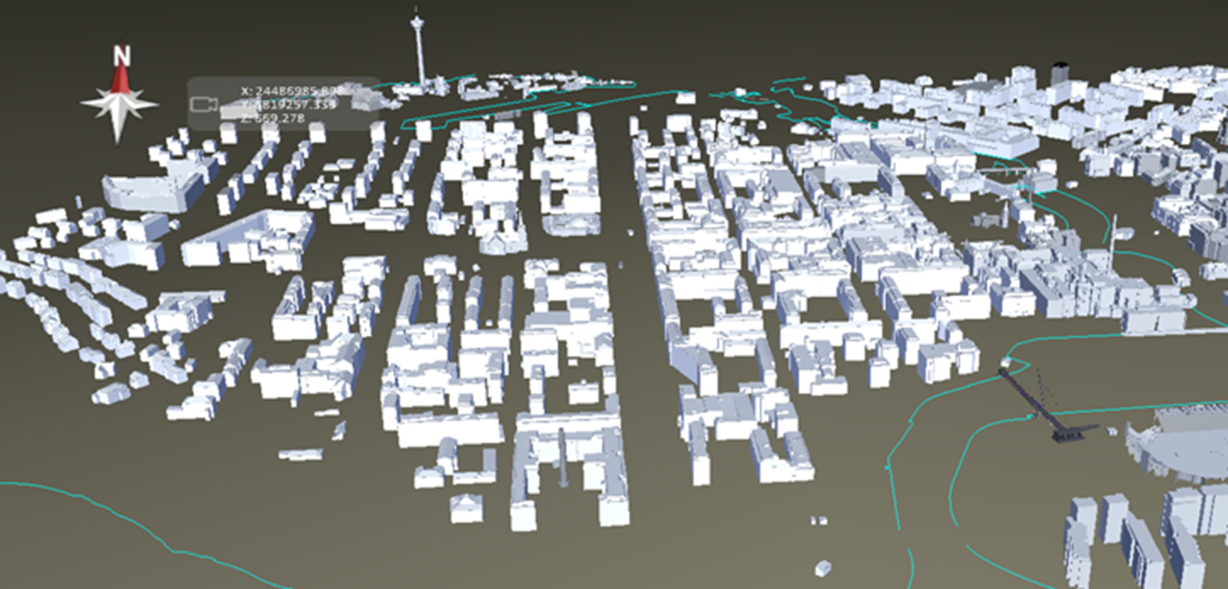
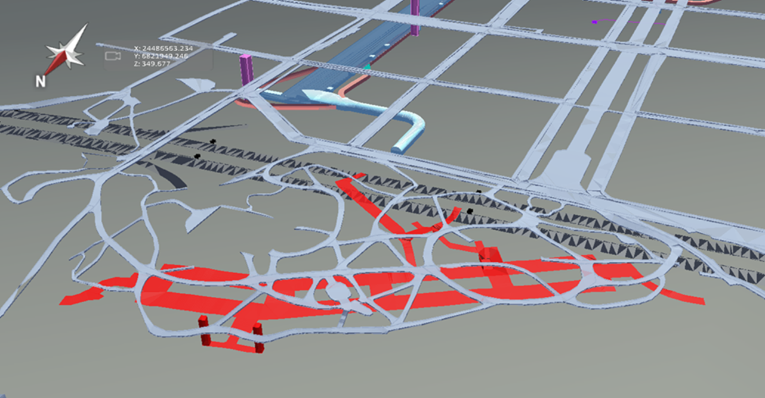
Buildings vectorised from laserscanned data (2011) with Microstation and Terrasolid
Terrain model – formed of Lidar (2011) and street boundary lines (2016)
Tunnels from the design and present state models

Slide 5
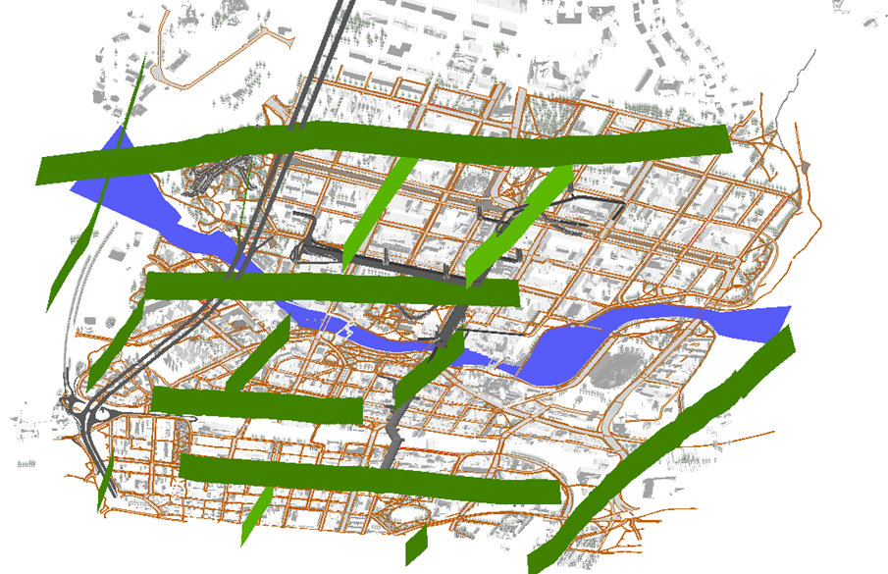
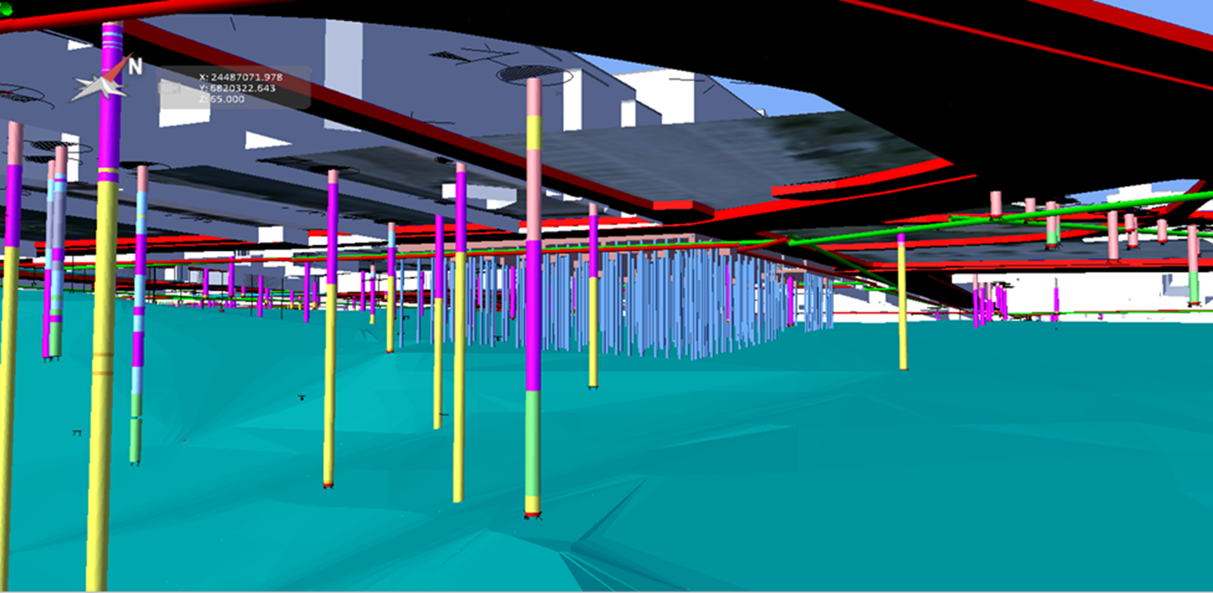
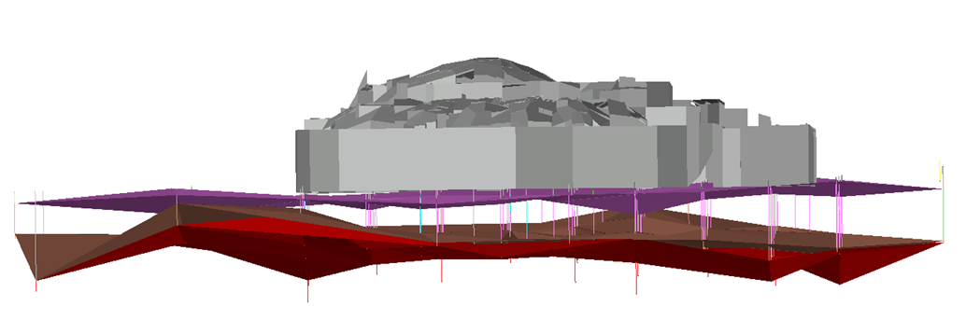
A combination of different information models integrated together
Faults modelled under the city center
Soil model for the public library in Tampere

Slide 6
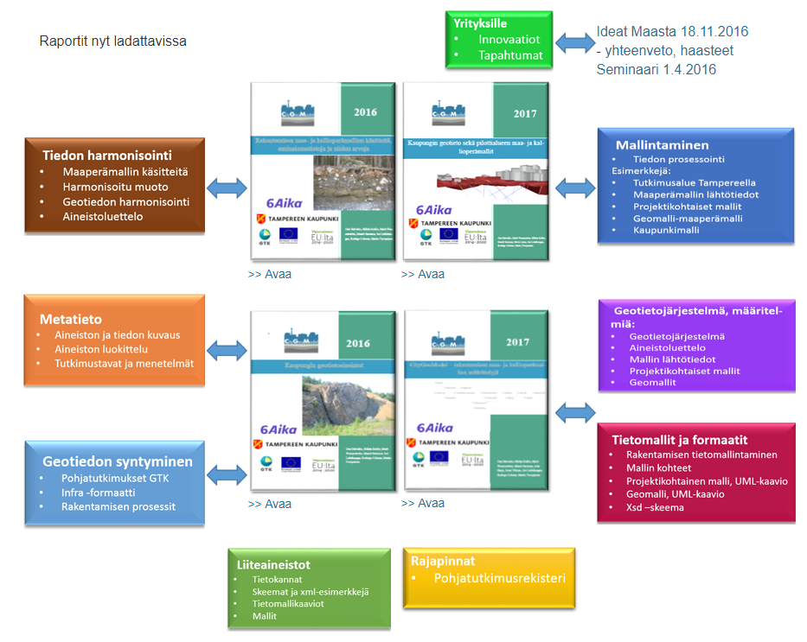
A brief look at the results - CityGeoModel – 2016-2017
http://www.citygeomodel.fi/tulokset_uusi.html

Slide 7
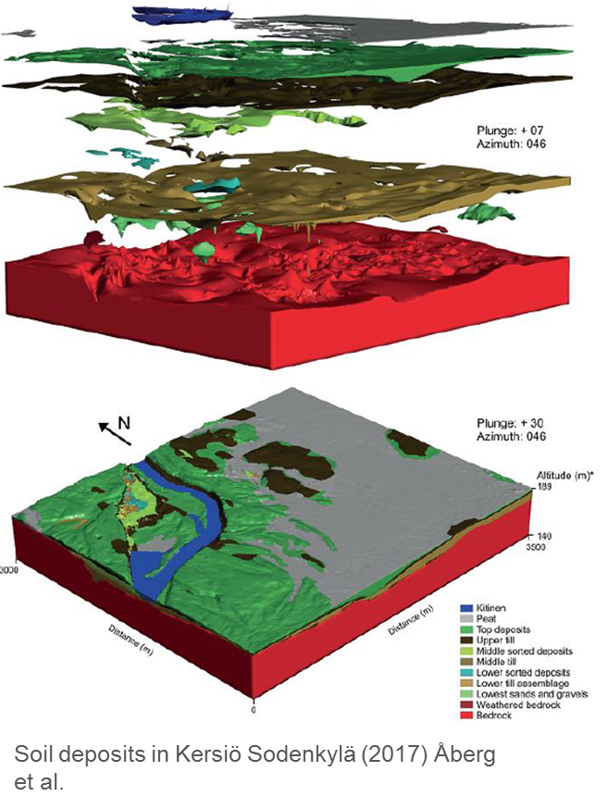

MAKUdigi - digital ground condition analysis for land use planning
Financiers:
KIRA-digi
Finnish Transport Agency
City of Espoo
City of Helsinki
City of Vantaa
City of Tampere
Geological Survey of Finland
Pilot cases:
Highway 12 Haarankylä-Mankala
Nygrannas Espoo
Koivusaari Helsinki
Aviapolis Vantaa
Ojala Tampere
Implementation:
Geological Survey of Finland
Sitowise – consulting for built environment services
Soil deposits in Kersiö Sodankylä (2017) Åberg et al.

Slide 8
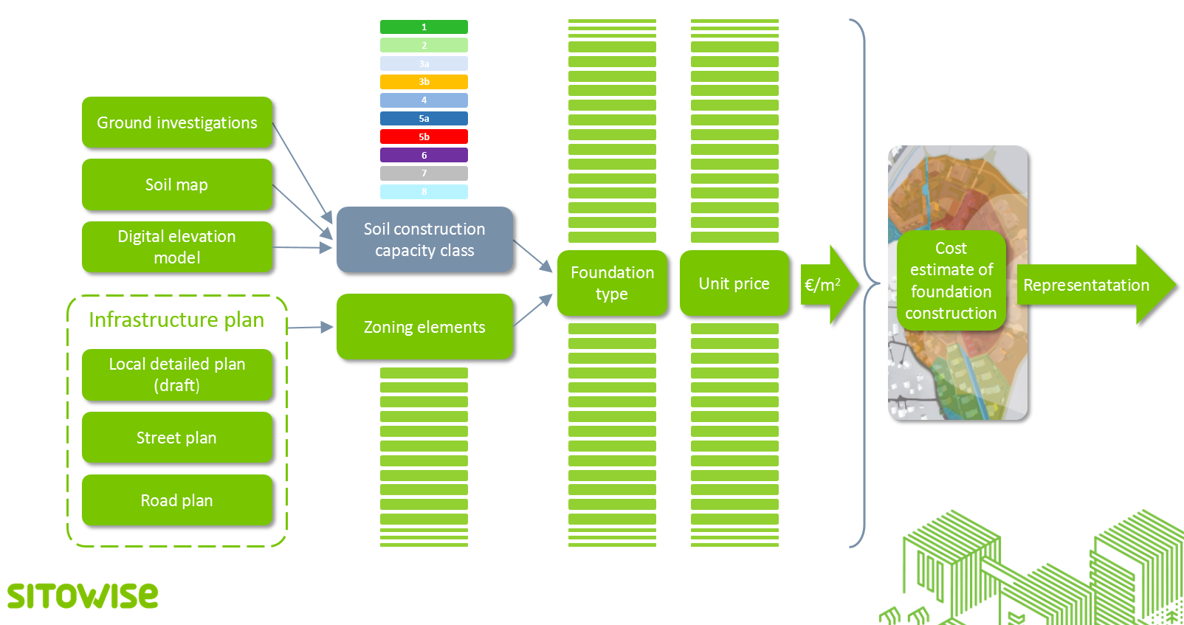
Process guideline – from grid based construction condition map towards cost estimate per zoning element
Classification improves awareness of foundation costs related on soil conditions

Slide 9
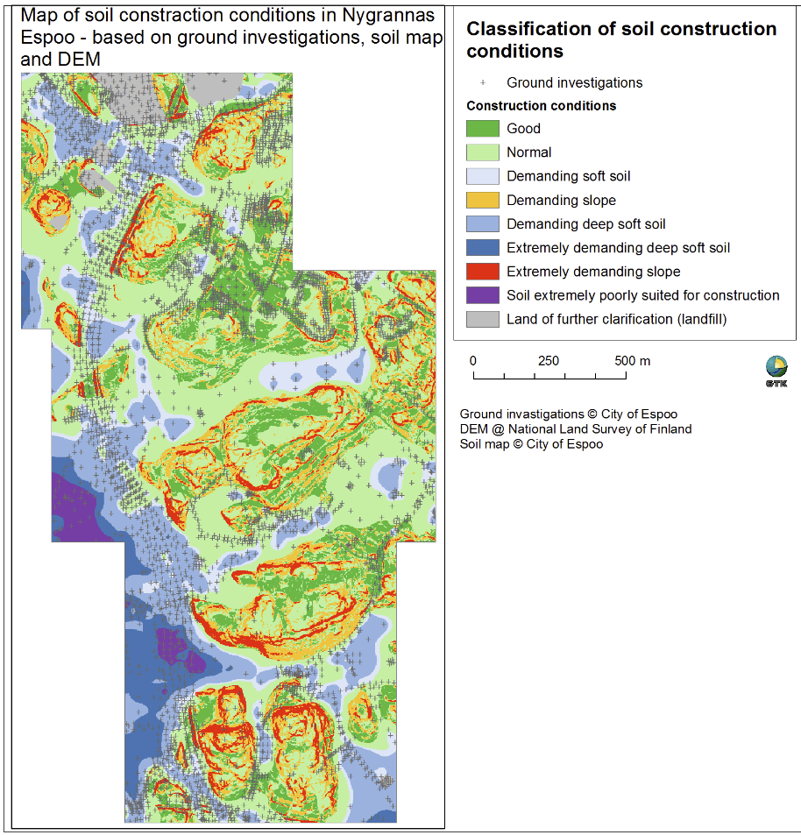
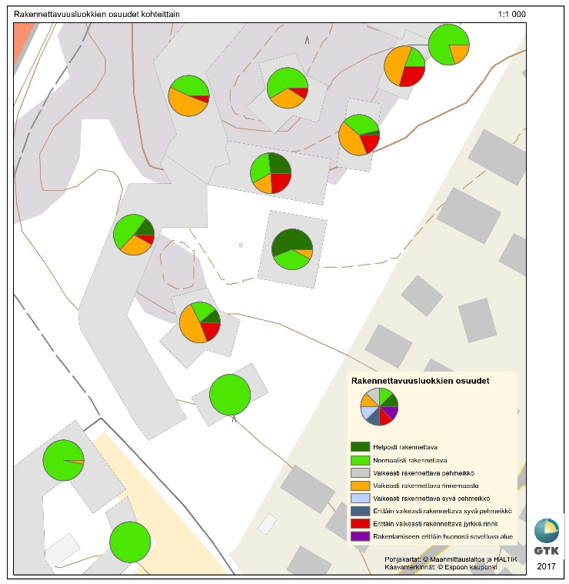
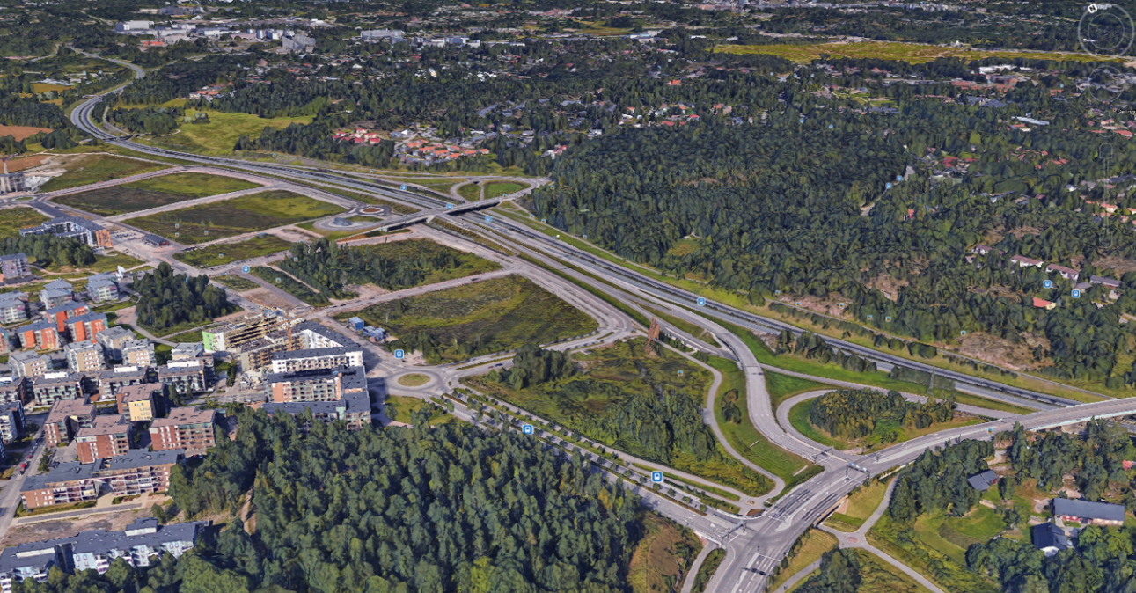

Slide 10
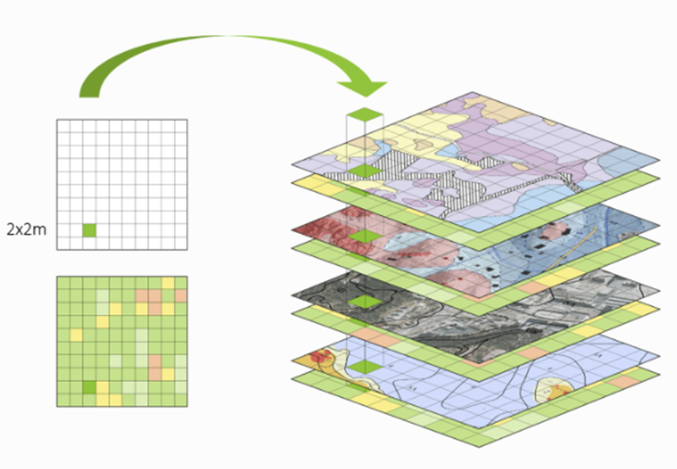

Classification improves awareness of foundation costs related on soil conditions
Follow-up tasks
Co-operation with project Land Use Decisions – managed by Ministry of Environment
Proposal for a national public administration guideline (JHS-suositus)
A specific tool to join digital soil construction information to cost information

Slide 11
makudigi.fi
citygeomodel.fi
Thank you for your attention!
Hilkka Kallio
Hilkka.kallio@gtk.fi

